Slide 1
System Software and Compiler Design
BCSSS602
3:0:2

Slide 2
Pre- requisites
Computer Organization
Any programming language
Data Structures
Automata Theory

Slide 3
Course Learning Objectives (CLO)
Understand the phases of the compiler
Generate parse table, Intermediate Code, and Target Code
Learn the concepts of System software – Assemblers and Loaders

Slide 4
MODULE 4
Code Generation:
The Target Language,
Basic blocks and flow graph,
Optimization of basic blocks,
The Code-Generation Algorithm
Introduction to Assembler
Machine Architecture of SIC and SIC/XE.,
Basic assembler functions

Slide 5
Issues in Design of code generator
The following are the design issues:
Input to the code generator
The target program
Instruction selection
Register Allocation
Evaluation order

Slide 6
Input to Code Generator
The input to the code generator is from the intermediate code generated by the compiler’s front-end.
This intermediate code is a higher-level representation of the program, like triples, quadruples, or abstract syntax trees.
Along with this intermediate code, the code generator also uses information from the symbol table, which holds the addresses of variables and other data objects.
One key challenge here is that the input must be free from syntactic and semantic errors, as the code generator assumes that proper type-checking and other error checks have already been handled by the front-end.
Handling the input correctly is crucial for generating the correct target code.

Slide 7
Target Program
The target program is the final output of the code generator, which can be in the form of absolute machine language, relocatable machine language, or assembly language. Each type of output has its own set of challenges:
Absolute Machine Language is easy to execute but lacks flexibility because it is bound to specific memory locations.
Relocatable Machine Language allows parts of the program to be moved around in memory, making it suitable for linking multiple modules, but it requires a linking loader.
Assembly Language is symbolic and needs an additional step (an assembler) to convert it into machine code, but it makes the code generation process easier.
Choosing the appropriate form for the target program depends on factors such as the program’s needs, execution environment, and whether the program will be linked with other modules.

Slide 8
Memory Management
Memory management in the code generation phase involves mapping variable names to their corresponding memory locations.
The code generator works closely with the front-end to access the symbol table, where memory addresses for variables are stored.
A major challenge is ensuring that the code generator uses memory efficiently, avoids memory conflicts, and correctly handles dynamic memory allocation.
This requires careful handling of variable storage, particularly for dynamically allocated objects or large data structures, such as arrays or objects in object-oriented languages.

Slide 9
Instruction Selection
Instruction selection is the process of choosing the most suitable machine instructions to translate intermediate code into executable code.
The goal is to optimize the generated code by selecting instructions that are efficient and appropriate for the target machine.
If the right instructions are not selected, the resulting code can be inefficient and slow.
A code generator might need to decide between different ways of implementing the same operation, such as using different addressing modes or optimizing for processor-specific features.

Slide 10
For example, the respective three-address statements would be translated into the latter code sequence as shown below:
Three Address Code:
P = Q + R S = P + T
MOV R0,Q ADD R0,R MOV P, R0 MOV R0, P --- Redundant code ADD R0, T MOV S, R0
MOV R0, Q ADD R0, R
MOV P, R0 ADD R0, T MOV S, R0

Slide 11
Register Allocation Issues
Efficient use of registers is important because registers are faster than memory, and utilizing them effectively can significantly improve program performance.
The challenge lies in selecting the right variables to store in registers at different points in the program.
Register allocation involves two stages:
Register Allocation: It is selecting which variables will reside in the registers at each point in the program
Register Assignment: Assigning specific registers to those variables selected in Register Allocation.
The difficulty arises in managing which variables are allocated to registers, especially when the number of available registers is limited.
Poor register allocation can lead to spills, where data is temporarily stored in memory, causing slower performance.

Slide 12
Evaluation Order
The evaluation order refers to the sequence in which expressions are evaluated in the generated code.
This order can significantly affect the efficiency of the program.
For example, evaluating certain expressions first might require fewer registers or fewer instructions.
The challenge is to determine the optimal order in which to execute operations so that the program requires fewer resources (like memory or registers) and runs more efficiently.
This is often a complex problem, as finding the best evaluation order can be computationally expensive, and in some cases, it may require sophisticated algorithms to find the optimal solution.

Slide 13
Code Generation
The Target Language – Assembly code
A Simple Target Machine Model - Our target computer models a three-address machine with load and store operations, computation operations, jump operations, and conditional jumps.
The underlying computer is a byte-addressable machine with n general-purpose registers, RO, R1, . . . , Rn - 1.
use a very limited set of instructions and assume that all operands are integers.
Most instructions consists of an operator, followed by a target, followed by a list of source operands.
A label may precede an instruction.

Slide 14
Instructions for code generation
Load operations: Move data from memory to register-
Instruction LD dst, addr loads the value in location addr into location dst.
LD r, x loads the value in location x into register r and LD rl, r2 loads the contents of register r2 into register r1.
Store operations: Move data from register to memory –
The instruction ST x, r stores the value in register r into the location x.
Computation operations OP dst, srcl, src2, where OP is a operator like ADD or SUB, and dst, srcl , and src2 are locations, not necessarily distinct.
For example, SUB rl , r2, r3 computes rl = r2 – r3
Any value formerly stored in rl is lost
Unary operators that take only one operand do not have a src2.

Slide 15
Unconditional jumps: The instruction BR L causes control to branch to the machine instruction with label L. (BR stands for branch.)
Conditional jumps of the form Bcond r, L, where r is a register, L is a label, and cond stands for any of the common tests on values in the register r.
For example, BLTZ r, L causes a jump to label L if the value in register r is less than zero, and allows control to pass to the next machine instruction if not.

Slide 16
Addressing Modes
Direct addressing - In instructions, a location can be a variable name x referring to the memory location that is reserved for x (that is, the l-value of x).
Indexed addressing - A location can also be an indexed address of the form a(r), where a is a variable and r is a register. The memory location denoted by a(r) is computed by taking the 1-value of a and adding to it the value in register r.
For example, the instruction LD R1, a(R2) has the effect of setting Rl = contents (a + contents (R2)), where contents(x) denotes the contents of the register or memory location represented by x.
This addressing mode is useful for accessing arrays, where a is the base address of the array (that is, the address of the first element), and r holds the number of bytes past that address, to reach one of the elements of array a.

Slide 17
Integer Indexed Addressing - A memory location can be an integer indexed by a register.
For example, LD R1, 100(R2) has the effect of setting R1 = contents(100 + contents(R2)), that is, of loading into R1 the value in the memory location obtained by adding 100 to the contents of register R2.
Indirect Addressing - two indirect addressing modes exist: *r means the memory location found in the location represented by the contents of register r and *100(r) means the memory location found in the location obtained by adding 100 to the contents of r.
For example, LD R1, *100(R2) has the effect of setting R1 = contents(contents(l00 + contents(R2))), that is, of loading into R1 the value in the memory location stored in the memory location obtained by adding 100 to the contents of register R2.
Immediate Addressing- immediate constant addressing mode. The constant is prefixed by #.
The instruction LD R1, #100 loads the integer 100 into register R1, and ADD R1, R1, #100 adds the integer 100 into register R1.

Slide 18
Example
The three-address statement x = y - z can be implemented by the machine instructions:
The machine instruction for b = a [i], where a is an array whose elements are 8-byte values, Also assuming elements of a are indexed starting at 0.

Slide 19
a[j] = c
x = *p
*p = y
if x < y goto L

Slide 20
Program and Instruction Costs
Cost of a program is associated with compiling and running a program.
Cost is measured depending on what aspect of a program that needs to be optimized.
Some common cost measures are the length of compilation time and the size, running time and power consumption of the target program.
Determining the actual cost of compiling and running a program is a complex problem.
Finding an optimal target program for a given source program is an undecidable problem in general, and many of the subproblems involved are NP-hard.

Slide 21
Program and Instruction Costs
Each target-language instruction has an associated cost , and the cost of an instruction to be one plus the costs associated with the addressing modes of the operands.
This cost corresponds to the length in words of the instruction.
Addressing modes involving registers have zero additional cost,
Addressing modes involving a memory location or constant in them have an additional cost of one, because such operands have to be stored in the words following the instruction.

Slide 22
Examples
The instruction LD R0, R1 copies the contents of register R1 into register R0. This instruction has a cost of one because no additional memory words are required. Register Addressing mode - 1 + 0 = 1
The instruction LD R0, M loads the contents of memory location M into register R0. The cost is two since the address of memory location M is in the word following the instruction. Direct Memory addressing mode - 1 + 1 = 2
Instruction LD R1, *100(R2) loads into register R1 the value given by contents(contents(l00 + contents(R2))). The cost is three because the constant 100 is stored in the word following the instruction. Indirect Addressing mode – 1 + 2 = 3

Slide 23
Exercise problems
x = 1 LD R1, #1 x = a + 1 LD R1, a x = b * c LD R1, b
ST x , R1 ADD R1, R1, #1 y = b + x LD R2, c
ST x , R1 MUL R2, R1, R2
ST x, R2
x = a LD R1, a x = a + b LD R1, a ADD R1, R1, R2
ST x , R1 LD R2, b ST y, R1
ADD R1, R1, R2
ST x , R1

Slide 24
Generate code for the following three-address statements assuming a and b are arrays whose elements are 4-byte values.
LD R1, i
MUL R1, R1, 4
LD R2, a(R1)
ST x, R2
LD R3, j
MUL R3, R3, 4
LD R4, b(R3)
ST y, R4
ST a(R1), R4
ST b(R3), R2
LD R1, i
MUL R1, R1, 4
LD R2, a(R1)
ST x, R2
LD R3, b(R1)
ST y, R3
MUL R3, R2, R3
ST z, R3
LD R1, i
MUL R1, R1, 4
LD R2, a(R1)
ST x, R2
LD R3, b(R2)
ST y, R3
ST a(R1), R3

Slide 25
Generate code for the following three-address sequence assuming that i, n, p, q, x and y are in memory locations:
if ( x < y )
x = y;
else
x = z;
if x < y goto L1
x = z
goto L2
L1: x = y
L2:
MOV R1, x
MOV R2, y
CMP R1, R2
BLTZ L1
MOV R3, z
ST x, R3
BR L2
L1: ST X, R2
L2:
LD R1, q
LD R2, 0(R1)
ST y, R2
ADD R1, R1, #4
ST q, R1
LD R3, y
LD R4, p
ST 0(R4), R3
ADD R4, R4, #4
ST p, R4

Slide 26
while (i < n)
{ i = i + 1; }
L1:
if i >= n goto L2
i = i + 1
goto L1
L2:
L1:
MOV R1, i
MOV R2, n
CMP R1, R2
BGTE L2
ADD R1, R1, #1
ST i, R1
BR L1
L2:

Slide 27
Basic Blocks and Flow Graphs
A graph representation of intermediate code that is helpful for discussing code generation even if the graph is not constructed explicitly by a code-generation algorithm.
The representation is constructed as follows:
Partition the intermediate code into basic blocks, which are maximal sequences of consecutive three-address instructions with the properties that
(a) The flow of control can only enter the basic block through the first instruction in the block. That is, there are no jumps into the middle of the block.
(b) Control will leave the block without halting or branching, except possibly at the last instruction in the block.
2. The basic blocks become the nodes of a flow graph, whose edges indicate which blocks can follow which other blocks.

Slide 28
Algorithm: Partitioning three-address instructions into basic blocks
INPUT: A sequence of three-address instructions.
OUTPUT: A list of the basic blocks for that sequence in which each instruction is assigned to exactly one basic block.
METHOD: First, determine those instructions in the intermediate code that are leaders, that is, the first instructions in some basic block.
The instruction just past the end of the intermediate program is not included as a leader.
The rules for finding leaders are:
The first three-address instruction in the intermediate code is a leader.
2. Any instruction that is the target of a conditional or unconditional jump is a leader.
Any instruction that immediately follows a conditional or unconditional jump is a leader
Then, for each leader, its basic block consists of itself and all instructions up to but not including the next leader or the end of the intermediate program.

Slide 29
Example
The leaders are instructions 1, 2, 3, 10, 12, and 13

Slide 30
Flow Blocks
Once an intermediate-code program is partitioned into basic blocks, the flow of control is represented between them by a flow graph.
The nodes of the flow graph are the basic blocks.
There is an edge from block B to block C if and only if it is possible for the first instruction in block C to immediately follow the last instruction in block B.
There are two ways that such an edge could be justified:
There is a conditional or unconditional jump from the end of B to the beginning of C.
C immediately follows B in the original order of the three-address instructions, and B does not end in an unconditional jump.
We say that B is a predecessor of C, and C is a successor of B.

Slide 31
Add two nodes, the entry and exit, that do not correspond to executable intermediate instructions.
There is an edge from the entry to the first executable node of the flow graph, that is, to the basic block that comes from the first instruction of the intermediate code.
There is an edge to the exit from any basic block that contains an instruction that could be the last executed instruction of the program.
If the final instruction of the program is not an unconditional jump, then the block containing the final instruction of the program is one predecessor of the exit, but so is any basic block that has a jump to code that is not part of the program.

Slide 32
The leaders are instructions 1, 2, 3, 10, 12, and 13

Slide 33
Translate the program into three-address statements Construct the flow graph

Slide 34
B1 1) i = 0
B2 2) if i >= n goto(13)
B3 3) j = 0
B4 4) if j >= n goto(11)
B5 5） t1 = n * i
6) t2 = t1 + j
7) t3 = t2 * 8
8) c[t3] = 0.0
9) j = j + 1
10) goto(4)
B6 11) i = i + 1
12) goto(2)
B7 13) i = 0
B8 14) if i >= n goto(40)
B9 15) j = 0
B10 16) if j >= n goto(38)
B11 17) k = 0
B12 18) if k >= n goto(36)
B13 19) t4 = n * i
20) t5 = t4 + j
21) t6 = t5 * 8
22) t7 = c[t6]
23) t8 = n * i
24) t9 = t8 + k
25) t10 = t9 * 8
26) t11 = a[t10]
27) t12 = n * k
28) t13 = t12 + j
29) t14 = t13 * 8
30) t15 = b[t14]
31) t16 = t11 * t15 32) t17 = t7 + t16 33) c[t6] = t17 34) k = k + 1 35) goto(18)
B14 36) j = j + 1 37) goto(16)
B15 38) i = i + 1 39) goto(14)

Slide 35
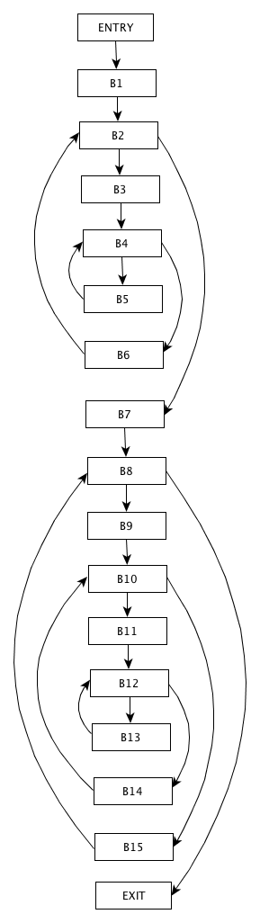
Flow graph

Slide 36
Next use information
Knowing when the value of a variable will be used next is essential for generating good code.
If the value of a variable that is currently in a register will never be referenced subsequently, then that register can be assigned to another variable.

Slide 37
Algorithm: Determining the liveness and next-use information for each statement in a basic block.
INPUT: A basic block B of three-address statements.
OUTPUT: At each statement i: x = y + z in B, we attach to i the liveness and next-use information of x, y, and z.
METHOD: We start at the last statement in B and scan backwards to the beginning of B.
At each statement i: x = y + z in B, we do the following:
1. Attach to statement i the information currently found in the symbol table regarding the next use and liveness of x, y, and z.
2. In the symbol table, set x to "not live" and "no next use."
3. In the symbol table, set y and z to "live" and the next uses of y and z to i

Slide 38
Optimization of Basic Blocks
The DAG Representation of Basic Blocks
Many important techniques for local optimization begin by transforming a basic block into a DAG (directed acyclic graph).
Construction of a DAG for a basic block is as follows:
There is a node in the DAG for each of the initial values of the variables appearing in the basic block.
There is a node N associated with each statement s within the block. The children of N are those nodes corresponding to statements that are the last definitions, prior to s, of the operands used by s.
Node N is labeled by the operator applied at s, and also attached to N is the list of variables for which it is the last definition within the block.
Certain nodes are designated output nodes. These are the nodes whose variables are live on exit from the block; that is, their values may be used later, in another block of the flow graph. Calculation of these "live variables" is a matter for global flow analysis

Slide 39
Advantages of DAG
The DAG representation of a basic block lets us perform several code improving transformations on the code represented by the block.
eliminate local common subexpressions, that is, instructions that compute a value that has already been computed.
eliminate dead code, that is, instructions that compute a value that is never used.
reorder statements that do not depend on one another; which may reduce the time a temporary value needs to be preserved in a register.
apply algebraic laws to reorder operands of three-address instructions, and sometimes t hereby simplify t he computation.

Slide 40
Finding Local Common Subexpressions
Common subexpressions can be detected by noticing, as a new node M is about to be added, whether there is an existing node N with the same children, in the same order, and with the same operator.
If so, N computes the same value as M and may be used in its place.

Slide 41
Dead Code Elimination
The operation on DAG's that corresponds to dead-code elimination can be implemented as follows;
Delete from a DAG any root (node with no ancestors) that has no live variables attached.
Repeated application of this transformation will remove all nodes from the DAG that correspond to dead code.
void example1()
{
int x = 10;
return; // Program exits here
x = 20; // Dead code
}

Slide 42
The Use of Algebraic Identities
Algebraic identities represent another important class of optimizations on basic blocks.
For example, use identities to eliminate computations from a basic block
Another class of algebraic optimizations includes replacing a more expensive operator by a cheaper one as in:
A third class of related optimizations is constant folding. Here we evaluate constant expressions at compile time and replace the constant expressions by their values. Thus the expression 2 * 3.14 would be replaced by 6.28.

Slide 43
Representation of Array References
Consider for instance the sequence of three address statements:
The proper way to represent array accesses in a DAG is as follows.
1. An assignment from an array, like x = a[i], is represented by creating a node with operator =[ ] and two children representing the initial value of the array, a0 in this case, and the index i. Variable x becomes a label of this new node.
2. An assignment to an array, like a[j] = y, is represented by a new node with operator []= and three children representing a0, j and y. There is no variable labeling this node.

Slide 45
A Simple Code Generator
One of the primary issues during code generation is deciding how to use registers to best advantage.
There are four principal uses of registers:
In most machine architectures, some or all of the operands of an operation must be in registers in order to perform the operation.
Registers make good temporaries - places to hold the result of a subexpression while a larger expression is being evaluated, or more generally, a place to hold a variable that is used only within a single basic block.
Registers are used to hold (global) values that are computed in one basic block and used in other blocks, for example, a loop index that is incremented going around the loop and is used several times within the loop.
Registers are often used to help with run-time storage management, for example, to manage the run-time stack, including the maintenance of stack pointers and possibly the top elements of the stack itself.

Slide 46
Translate the basic block consisting of the three-address statements
Assume that t, u, and v are temporaries, local to the block, while a, b, c, and d are variables that are live on exit from the block.
Restrict the use of registers based on reusability, hence only 3 registers are sufficient

Slide 48
x= a/(b+c)-d*e
 | R1 | R2 | R3 |  | a | b | c | d | e | x | t1 | t2 | t3
t1 = b + c |  |  |  |  | a | b | c | d | e
LD R1, b | b |  |  |  | a | b,R1 | c | d | e
LD R2, c | b | c |  |  | a | b,R1 | c, R2 | d | e
ADD R1, R1, R2 | t1 | c |  |  | a | b | c, R2 | d | e |  | R1
t2 = a / t1
LD R2, a | t1 | a |  |  | a, R2 | b | c | d | e |  | R1
DIV R1, R2, R1 | t2 | a |  |  | a, R2 | b | c | d | e |  |  | R1
t3 = d*e
LD R2, d | t2 | d |  |  | a | b | c | d,R2 | e |  |  | R1
LD R3, e | t2 | d | e |  | a | b | c | d,R2 | e,R3 |  |  | R1
MUL R2, R2, R3 | t2 | t3 | e |  | a | b | c | d | e,R3 |  |  | R1 | R2
x = t2 – t3
SUB R2, R2, R3 |  | x | e |  | a | b | c | d | e,R3 | R2 |  | R1
ST x, R2 |  | x | e |  | a | b | c | d | e,R3 | x, R2 |  | R1

Slide 49
Introduction to System Software
System software consists of a variety of programs that support the operation of a computer
Ex., - Text editor, compiler, loader or linker, debugger, macro processors, operating system, database management systems, software engineering tools, ….
System software differs from application software in machine dependency
System programs are intended to support the operation and use of the computer itself, rather than any particular application.

Slide 50
Simplified Instructional Computer (SIC)
SIC is a computer that includes the hardware features most often found on real machines, while avoiding unusual or irrelevant complexities
Like many other products, SIC comes in two versions
The standard model (SIC)
SIC/XE version‒ “extra equipment”, “extra expensive”
The two versions have been designed to be upward compatible

Slide 51
SIC Machine Architecture
Memory – Memory consists of 8-bit bytes, 15-bit addresses, Any 3 consecutive bytes form a word (24 bits)
Total of 32768 (215) bytes in the computer memory
Registers – Five registers, each is 24 bits in length

Slide 52
SIC
Data Formats -
24-bit integer representation in 2’s complement
8-bit ASCII code for characters
No floating-point on standard version of SIC
Instruction formats
Standard version of SIC
The flag bit x is used to indicate indexed addressing mode

Slide 53
SIC-
Addressing modes - Two addressing modes ‒ Indicated by the x bit in the instruction
(X): the contents of register X

Slide 54
SIC -Instruction set: (Textbook-Appendix A, Page 495)
Load/store registers: LDA, LDX, STA, STX
Integer arithmetic: ADD, SUB, MUL, DIV
All involve register A and a word in memory, result stored in register A
COMP - Compare value in register A with a word in memory
Set a condition code CC (<, =, >)
Conditional jump instructions - JLT, JEQ, JGT: test CC and jump
Subroutine linkage - JSUB, RSUB: return address in register L

Slide 55
SIC -Input and output
Performed by transferring 1 byte at a time to or from the rightmost 8 bits of register A
Each device is assigned a unique 8-bit code, as an operand of I/O instructions
Test Device (TD): < (ready), = (not ready)
Read Data (RD), Write Data (WD)

Slide 56
SIC – program example - Data movement
LDA FIVE load 5 into A reg
STA ALPHA store in ALPHA from reg A
LDCH CHARZ load ‘Z’ into A
STCH C1 store in C1
.
.
.
ALPHA RESW 1 reserve one word space for variable ALPHA
FIVE WORD 5 one word holding 5
CHARZ BYTE ’Z’ one-byte constant
C1 RESB 1 one-byte variable

Slide 57
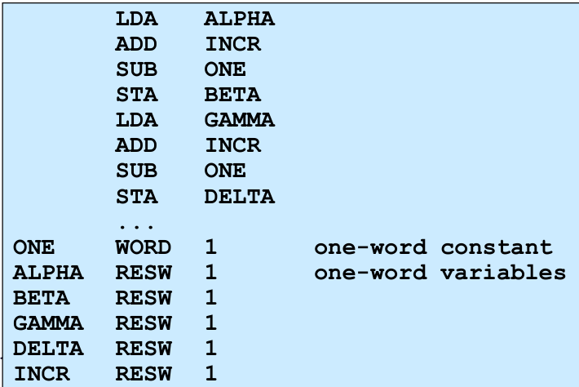
Arithmetic operations: BETA = ALPHA + INCR - 1 DELTA = GAMMA + INCR -1

Slide 58
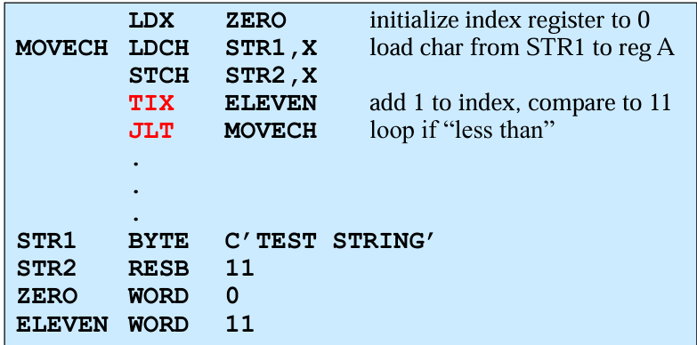
Looping and indexing: copy one string to another

Slide 59
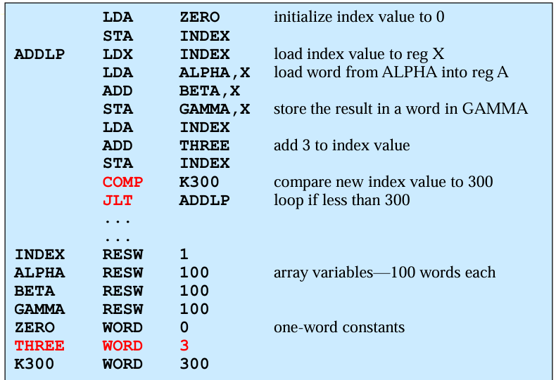

Slide 60
SIC/XE Machine Architecture
Memory - Maximum memory available on a SIC/XE system is 1 megabyte (220 bytes)
An address (20 bits) cannot be fitted into a 15-bit field as in SIC Standard
Must change instruction formats and addressing modes
Registers - Additional registers are provided by SIC/XE

Slide 61
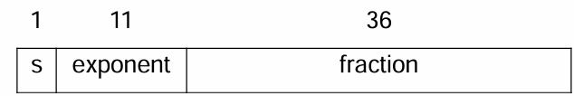
SIC/XE
Data formats - There is a 48-bit floating-point data type
fraction is a value between 0 and 1
exponent is an unsigned binary number between 0 and 2047
zero is represented as all 0
2^{(e-1024)}

Slide 62
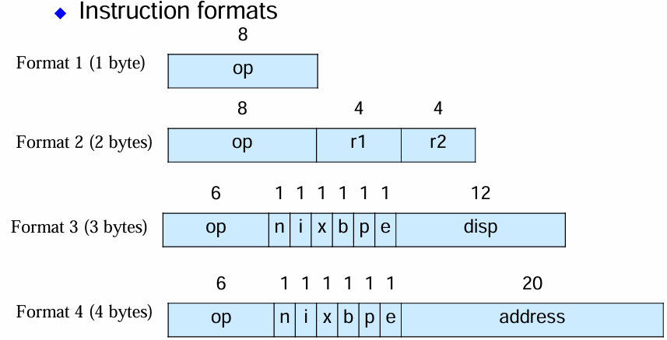
Formats 1 and 2 do not refer memory
Bit e distinguishes between format 3 and 4

Slide 63
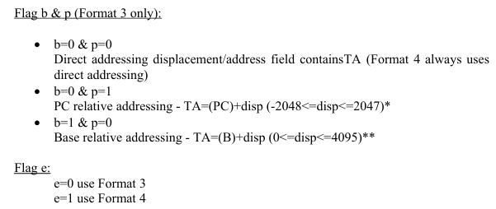

Slide 64
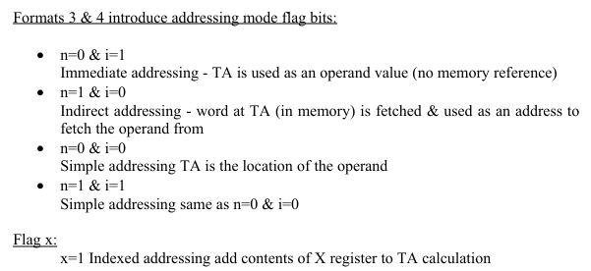

Slide 65
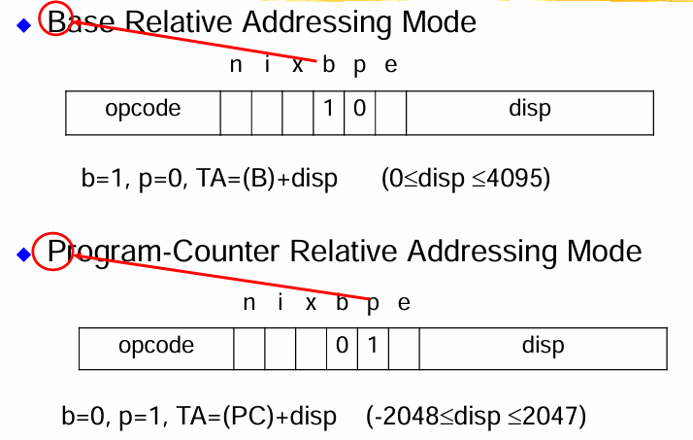

Slide 66
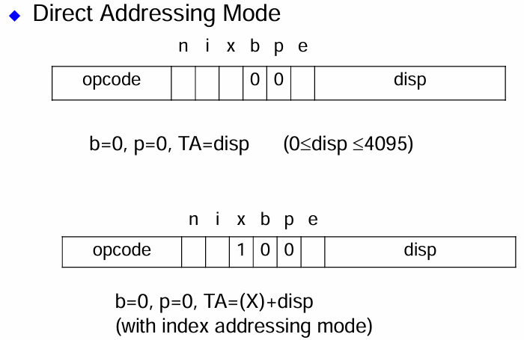

Slide 67
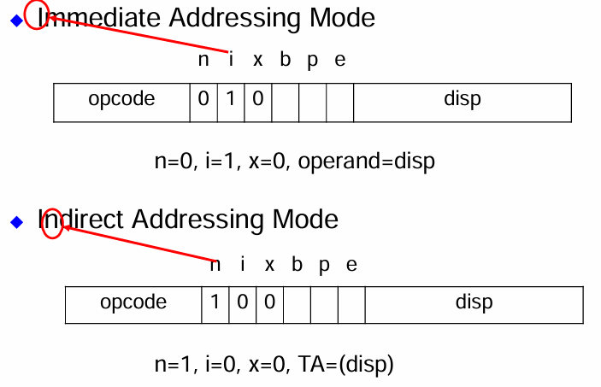

Slide 68
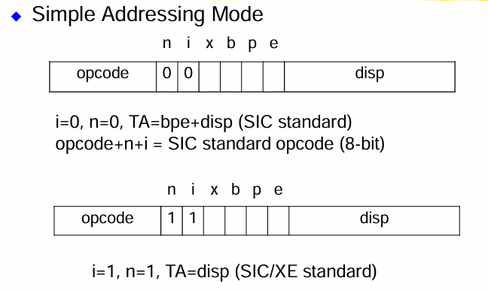

Slide 69
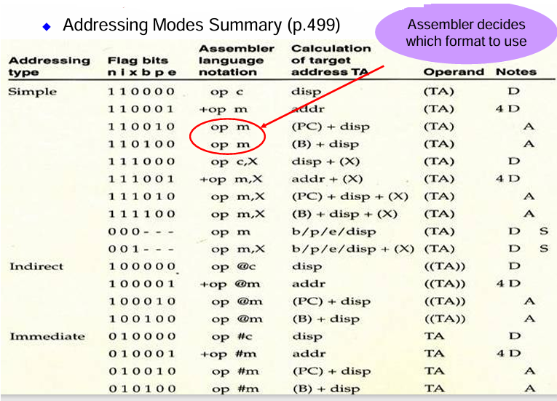

Slide 70
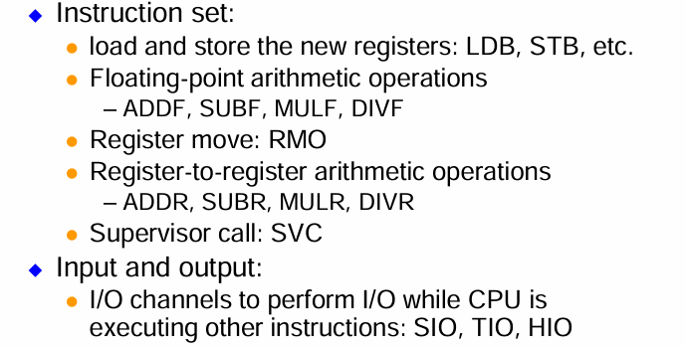

Slide 71
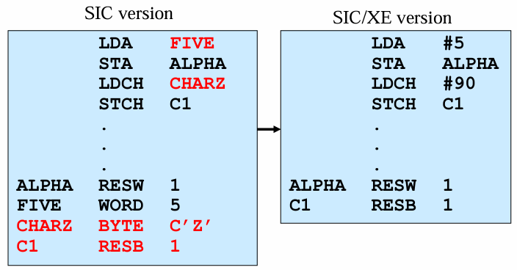

Slide 72
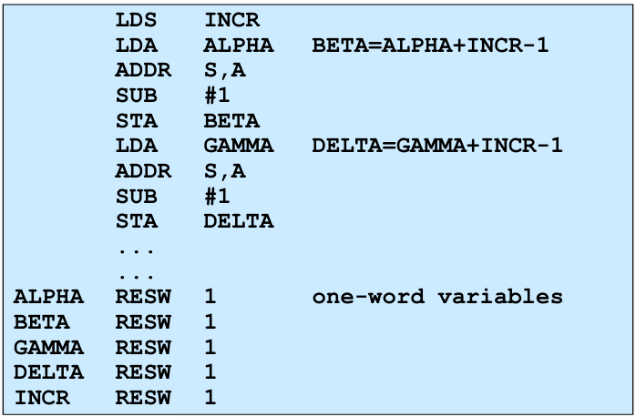
SIC/XE Program

Slide 73
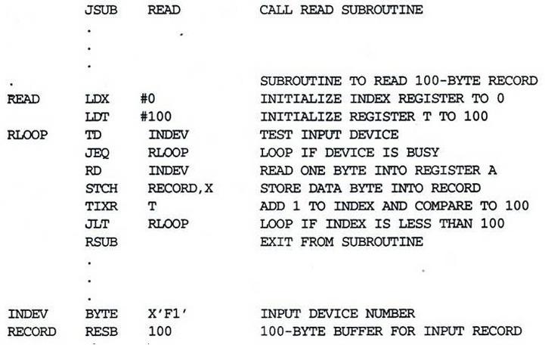
SIC/XE example program

Slide 74
BASIC ASSEMBLER FUNCTIONS
Fundamental functions of an assembler:
Translating mnemonic operation codes to their machine language equivalents.
Assigning machine addresses to symbolic labels used by the programmer
Along with the instructions the following assembler directives are used:
START: Specify name and starting address for the program.
END : Indicate the end of the source program and specify the first executable instruction in the program.
BYTE: Generate character or hexadecimal constant, occupying as many bytes as needed to represent the constant.
WORD: Generate one- word integer constant.
RESB: Reserve the indicated number of bytes for a data area.
RESW: Reserve the indicated number of words for a data area

Slide 75
The program contains a main routine that reads records from an input device( code F1) and copies them to an output device(code 05).
The main routine calls subroutines:
RDREC – To read a record into a buffer.
WRREC – To write the record from the buffer to the output device.
The end of each record is marked with a null character (hexadecimal 00).

Slide 76
A Simple SIC Assembler
The translation of source program to object code requires the following functions:
1. Convert mnemonic operation codes to their machine language equivalents. Eg: Translate STL to 14 (line 10).
Convert symbolic operands to their equivalent machine addresses. Eg:Translate RETADR to 1033 (line 10).
Build the machine instructions in the proper format.
Convert the data constants specified in the source program into their internal machine representations. Eg: Translate EOF to 454F46(line 80).
Write the object program and the assembly listing. All functions except function 2 can be established by sequential processing of source program one line at a time.

Slide 77
Consider the statement
1000 FIRST STL RETADR 141033
This instruction contains a forward reference (i.e.) a reference to a label (RETADR) that is defined later in the program.
It is unable to process this line because the address that will be assigned to RETADR is not known.
Hence most assemblers make two passes over the source program where the second pass does the actual translation.
The assembler must also process statements called assembler directives or pseudo instructions which are not translated into machine instructions.
Instead they provide instructions to the assembler itself.
Examples: RESB and RESW instruct the assembler to reserve memory locations without generating data values.
The assembler must write the generated object code onto some output device.
This object program will later be loaded into memory for execution.

Slide 78
Object Program
Object program format contains three types of records:
Header record: Contains the program name, starting address and length.
Text record: Contains the machine code and data of the program.
End record: Marks the end of the object program and specifies the address in the program where execution is to begin.

Slide 79
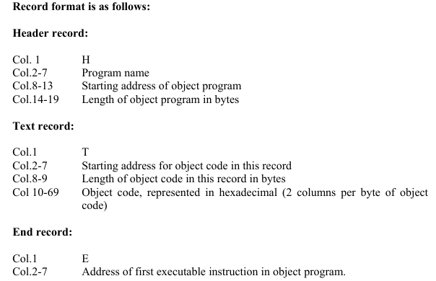

Slide 80
THANK YOU

